Slide 1

Systems analysis activities
Requirement analysis
Viet-Trung Tran
trungtv.github.io
School of Information and Communication Technology

Slide 2

Outline

Slide 3
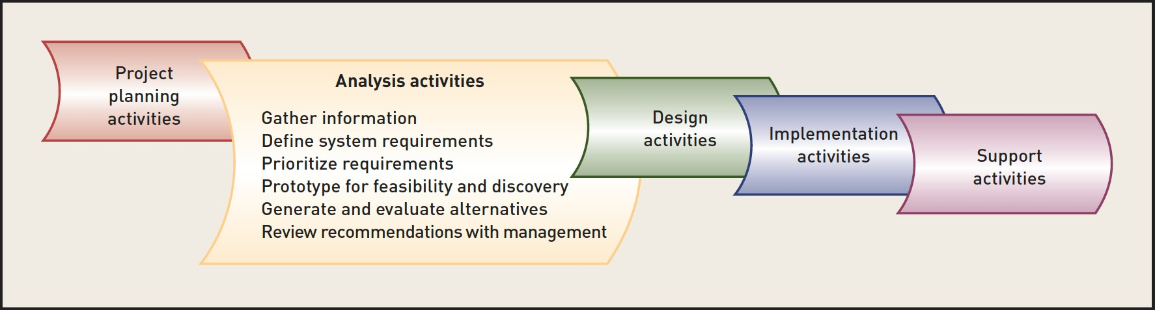
Analysis activities
Requirements Analysis and Gathering
Modeling
Stakeholders
Information gathering

Slide 4
Gathering Requirements
Regardless of what we want to do
Improve
Update
Replace
We need to gain a deep understanding of the requirements
be systematic
document and communicate these requirements
refine the requirements

Slide 5
Gather details about the system
What does the system need to do?
This is called systems analysis
Multiple passes will likely be required
first pass: is an update needed? Possible?
second pass: gather detailed information about what the system does
subsequent passes: refine and correct requirements

Slide 6
Gathering Detailed Information
What kinds of information should we gather?
How should we gather it?
From whom?
Techniques
Interview users of the system
Observe users of the system
Review documentation
Review organization policies
Study existing solutions (outside of org.)
Study how other companies have dealt with similar change

Slide 7
DEFINE SYSTEM REQUIREMENTS
System requirements are specifications that define the functions to be provided by a system
Functional requirements
functions the system must perform
Non-functional requirements
UI formats
Performance needs
Security needs
Reliability needs

Slide 8
Prioritizing Requirements
Which are most important?
Which are least important?
Weed out “requirements” that aren’t really necessary

Slide 9
PROTOTYPE FOR FEASIBILITY AND DISCOVERY
Develop some UI dialogs
Users’ input is necessary to ensure the system works
Prototypes
storyboards
Need a way to test the system to see
if it makes sense to users
if it meets the users’ needs
UI dialogs are a good approach because
they will elicit more feedback than just asking questions
users should be able to make sense of it
Should represent all working portions of this iteration

Slide 10
GENERATE AND EVALUATE ALTERNATIVES
When requirements are prioritized, the analyst can generate several alternatives by eliminating some of the less important requirements
Key question: What is the best way to create the system?

Slide 11
User-evaluation
Done iteratively
you should get feedback
inform changes
users’ time is valuable
will likely only get short sessions
Early iterations
quick and dirty
paper prototypes, storyboards
Later iterations
higher-fidelity
more interactional
Review recommendations with management

Slide 12
Types of Requirements
Functional requirements
Non-functional requirements (FURPS)
Additional non-functional requirements (FURPS+)

Slide 13
Functional Requirements
Activities of the system that must be performed
Business Uses
calculate payroll taxes
generate timesheets
Based on the rules and processes of the organization
Discovering all these requirements is vital and difficult
If you don’t get it right, your solution will not be well received

Slide 14
Non-functional Requirements (FURPS)
characteristics of the system other than activities it must perform or support, such as technology, performance, usability, reliability, and security

Slide 15
Non-functional Requirements (FURPS)
Usability requirements
describe operational characteristics related to users, such as the user interface, related work procedures, online help, and documentation
menu placement and format, color schemes, use of the organization’s logo, etc.
Reliability requirements
How often do service interruptions or outages occur?
How does the system detect and cope with errors?
Performance requirements
describe operational characteristics related to measures of workload, such as throughput and response time
Security requirements
describe which users can perform what system functions under what conditions
Technical requirements
describe operational characteristics related to the environment, hardware, and software of the organization

Slide 16
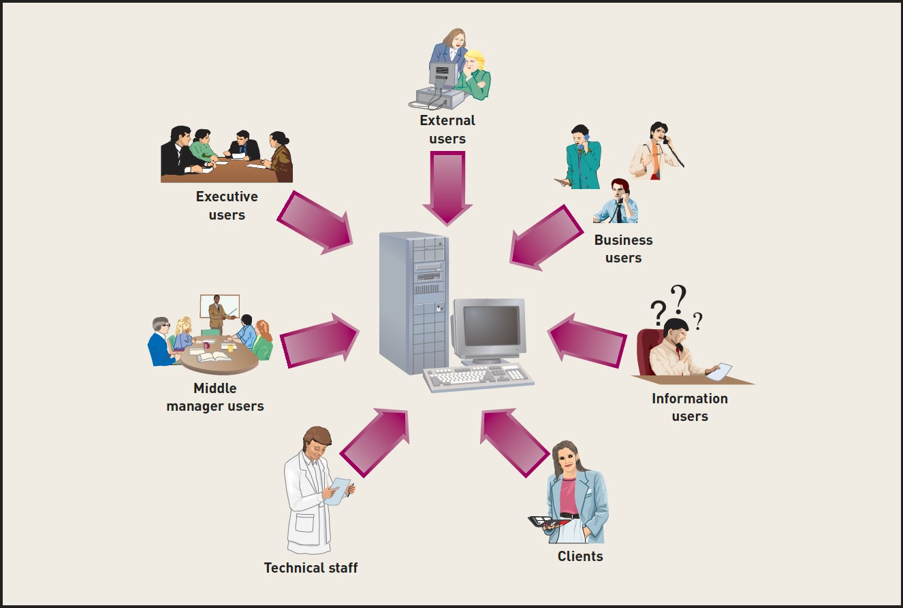
STAKEHOLDERS—THE SOURCE OF SYSTEM REQUIREMENTS
All the people who have an interest in the success of a new system

Slide 17
Identifying Stakeholders
Internal Stakeholders
Employees
people who use the system
people who’s job is impacted by the system
External Stakeholders
Suppliers
Partners
shipping companies
Students

Slide 18
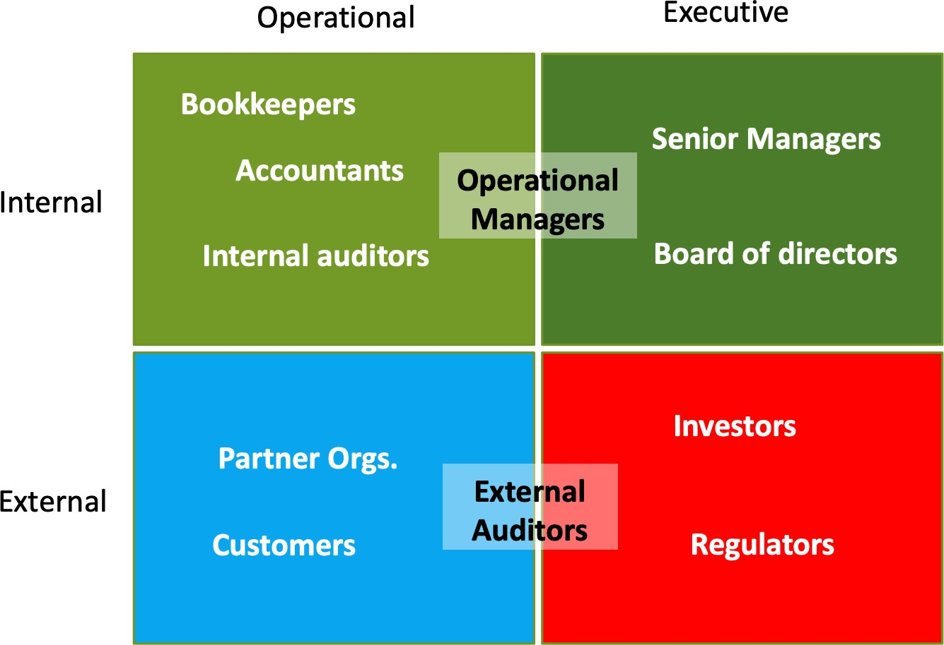
Identifying Stakeholders
Operational stakeholders
direct users of the system
Executive stakeholders
don’t interact with the system

Slide 19
TECHNIQUES FOR INFORMATION GATHERING
Interviews
Questionnaires
System inputs and outputs
Documentation
Observation
Research other solutions
Gather user comments and suggestions

Slide 20
Asking the right questions
How to develop good questions
Identify important themes
Create questions that target each theme
Have both open and closed ended questions
How to get an interview right
prepare, prepare, prepare
plan ahead
arrive with enough time
keep interview short
pay attention for exceptions or problems
details, details, details
take good notes
follow up on the interview

Slide 21
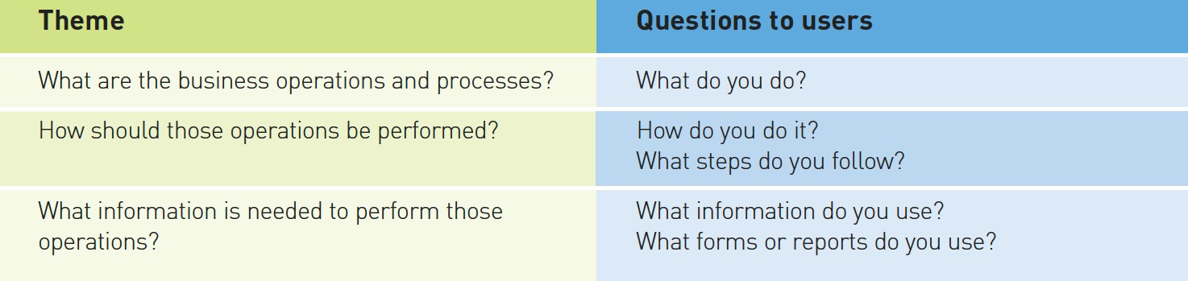
Important themes
What are the business processes?
keep in mind difference between existing and new system
the system may take over steps that the worker used to do
How should business operations be performed?
how will new system change these operations?
how will new system support these operations?
how can new tech/systems make processes more efficient
What info is needed to perform business operations?
formal and informal information
look for exceptions and unusual situations
identify non-routine information requirements

Slide 22
Models and Modeling
A model is not only documentation produced after the analysis and design work is done
The process of creating a model helps an analyst clarify and refine the design
Models are useful for
communicating ideas to others
showing that you understand the system
finding errors
learning about the system
dealing with complexity
Documentation for later
Maintenance
Updates
upgrades

Slide 23
Logical model
Two types of system models are created to help record and communicate what is required
A logical model shows what the system is required to do in great detail, without committing to any one technology
focus its efforts first on what is needed, not what form it will take
A physical model, on the other hand, shows how the system will actually be implemented.
Systems analysis involves creating detailed logical models, and systems design involves detailed physical models.

Slide 24
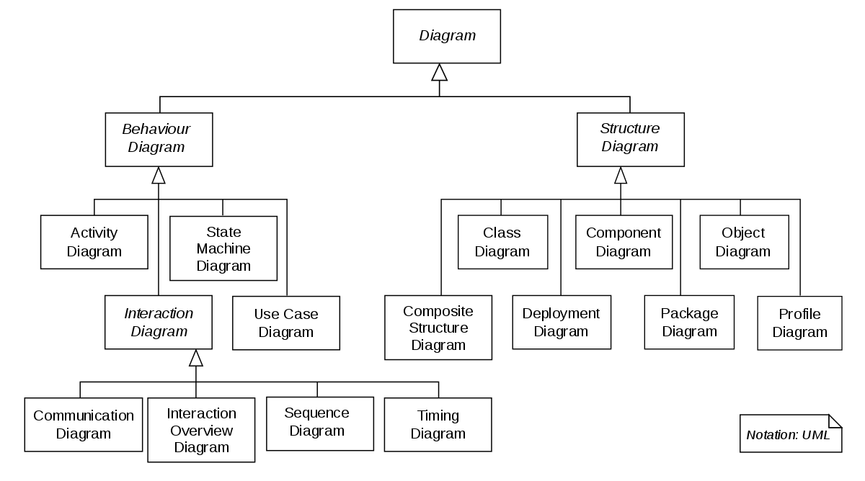
Kinds of Model
Textual model
Graphical models
UML
Mathematical models

Slide 25
Validating the requirements
Structured walkthrough is a review of the findings from your investigation and of the models built based on those findings
What and when
smaller walkthroughs every week or two with members of the project team
Who
it is best to have other experienced analysts involved
the appropriate stakeholders should be involved
A librarian, a helper for the presenter, documents the comments made by the reviewers.
How
prepares material for review
presents the material point by point

Slide 26
Practice Questions
The real estate business relies on an extensive amount of information used in the buying and selling of real property. Most communities of real estate agents and brokers have formed cooperative organizations to help consolidate and distribute information on the real estate profession, real estate trends, properties in the community, historical records of property sales, and current listings of properties for sale. These organizations are usually referred to as the Community Board of Realtors.
Try to answer these questions:
1. Who are the stakeholders for the issues related to real estate in your community, and what are their main interests?
2. What types of information do you think the board collects and make available to its members and to the community?
3. What are some cultural and legal issues that impact real estate in Canada.
4. If you were working on support for an international real estate cooperative system, in what ways would the information collection activity process be complicated?

Slide 27

Thank you for your attention! Q&A

